Slide 1
Module 4: Migrate Activate SharePoint Online Migration
ETHAN IRONS
Notes:
We'll finally dive into the actual migration and tools (I.e., SPMT) in this module

Slide 3
How to view this presentation?
To switch to the Notes Page view:
On the ribbon, select the View tab, and then select Notes Page
To navigate through notes, use the Page Up and Page Down keys
Zoom in or zoom out, if required
In the Notes Page view, you can:
Read any supporting text—now, or after the delivery
Add notes to your copy of the presentation, if required
Take the presentation files home with you

Slide 4
Objective

Slide 5
Sections
In this lesson, you will learn:
Performance Expectations
Migration APIs
SharePoint Migration Tool (SPMT)
Migration Tools and Service Options
Migration Manager
Mover

Slide 6
Migration Tools and Service Options

Slide 7

Migration Tools and Service Options
Microsoft provided migration tools
Third-party migration tools (ISV)
FastTrack Center (FTC)
Microsoft Consulting Services (MCS)
Migration Service Providers (Partners)

Slide 8
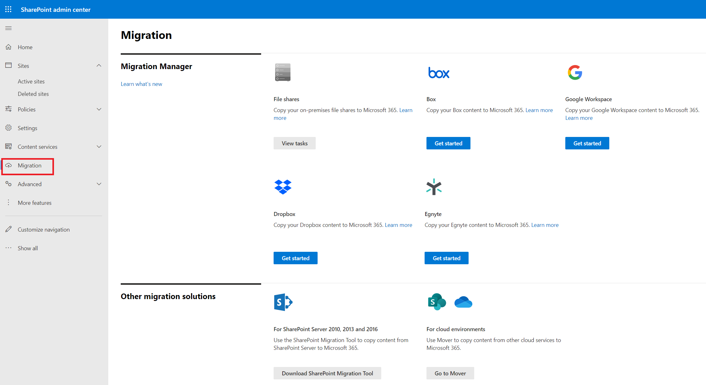
How to Access Microsoft’s Migration Tools
https://<tenantname>-admin.sharepoint.com/_layouts/15/online/AdminHome.aspx#/migration

Slide 9
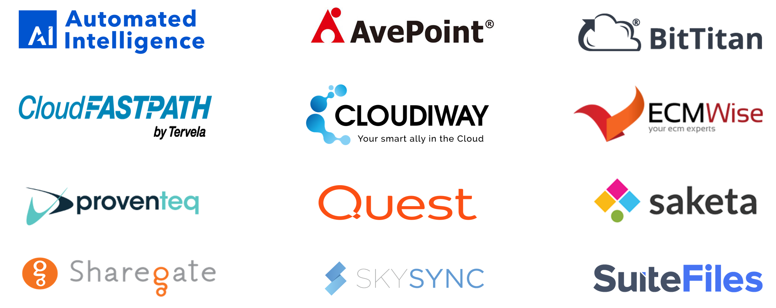
Third-Party Migration Tools (ISV)
Notes:
Third-party tools utilize the Microsoft Migration Service API to perform the migration.
Third-party tools that support migration of content to OneDrive for Business and SharePoint Online:
This is not an endorsement of any specific tools.
There are many other tools than what is shown on the slide.

Slide 10
Migration Offerings
Customer Self-Service
FastTrack Driven
MCS or Partner Driven
Requires infrastructure: VPNs, test environment, admin environment, etc.
MCS Accelerators: SharePoint Content Assessment / Content Migration.
Highly structured process and schedule.
Professional services from partners in the Microsoft Partner Center
Price dependent on complexity.
No cost (included in your subscription).
File Share migrations only
Use free Microsoft tool or purchase an ISV tool.
Flexible process.
Consider hiring resources with migration expertise.
Customized to your needs.
Contact your CSAM for more information.
https://docs.microsoft.com/en-us/partner-center/
Notes:
Customer Self-Service
Use free Microsoft tool or purchase an ISV tool.
Flexible process.
Consider hiring resources with migration expertise.
MCS or Partner Driven
MCS Accelerators: SharePoint Content Assessment / Content Migration.
Price dependent on complexity. Customized to your needs. Contact your CSAM for more information.
Alternately, explore professional services from partners in the Microsoft Partner Center
FastTrack Driven
No cost (included in your subscription).
File Share migrations only
Highly structured process and schedule.
Requires infrastructure: VPNs, test environment, admin environment, etc.
Customer Self-Service
Use free Microsoft tool or purchase an ISV tool.
Flexible process. You set the pace. No need to configure complex infrastructure.
Consider hiring resources with migration expertise.

Slide 11
Azure Data Box
For large file share migrations (TB’s, PB’s)
Used in combination with SPMT
Not a free service.
Available for Enterprise Agreement (EA), Cloud solution provider (CSP), or Pay-as-you-go subscription offers.
Data box sizes: Disk (40TB), Box (100TB), Box Heavy (1PB)
Not suitable for incremental migrations.
Notes:
https://docs.microsoft.com/en-us/sharepointmigration/how-to-migrate-file-share-content-to-spo-using-azuredatabox
Microsoft Azure Data Box is for large migrations of file share data (TB’s).
Used in combination with the SharePoint Migration Tool (SPMT).
There is a cost for this service.
Available for Enterprise Agreement (EA), Cloud solution provider (CSP), or Pay-as-you-go subscription offers.
Data box sizes:
Data Box Disk (40TB)
Data Box (100TB)
Data Box Heavy (1PB)

Slide 12
Migration API
Notes:
Regardless of what offering path you choose to get your data into SharePoint Online you will use the Migration API. This section will cover the concepts for a migration regardless of what tool or method you use.

Slide 13
Migration API Overview
Several APIs could be used to ingest content:
Client-Side Object Model (CSOM), Java Script Object Model (JSOM), REST Endpoints, Microsoft Graph API and Migration Service API
The Migration Service API is the only API that scales well for migration.
Do not attempt large scale migrations using other options!
Migration tools use the Migration Service API.
Migration API runs as a background activity.
Notes:
Migration performance guide for SharePoint & OneDrive - Migrate to Microsoft 365 | Microsoft Docs
SharePoint Online has several APIs that could be used to ingest content:
Client-Side Object Model (CSOM), Java Script Object Model (JSOM), REST Endpoints, Microsoft Graph API and Migration Service API
The Migration Service API is the only API that scales well for migration. Don’t attempt large scale migrations using other options.
Migration tools from Microsoft or ISV’s use the Migration Service API.
The Migration Service API runs as a background activity and does not compete with end-user traffic, however it can be throttled during peak hours, along with other backend activity, like backup solutions, DLP, etc.

Slide 14








Migration API Flow
Azure Blob Storage
Create a package using a tool
Package
2
Upload the package
Manifest
[Container]
Read/List/Write
Notification
[Queue]
Add/Remove
Content
[Container]
Read/List
SharePoint Server
3
SPMT or ISV tool
File Share Server
File upload to SPO
Manifest Read/Write
Update the queue
Put log in the Manifest
5
4
CSOM : Create target site/Web/List Structure
Personal Files
1
SharePoint Online
Legend
CSOM : Site.CreateMigration
Site ID
WebID + + +
Web ID
Symmetrical SAS Key
Notes:
Deep details on Migration API for development –
Import Migration - https://docs.microsoft.com/en-us/sharepoint/dev/apis/migration-api-overview
Export Migration API - https://docs.microsoft.com/en-us/sharepoint/dev/apis/export-amr-api
Azure Container and queue - https://docs.microsoft.com/en-us/sharepoint/dev/apis/migration-api-azure-container-and-queue
Encryption - https://docs.microsoft.com/en-us/sharepoint/dev/apis/migration-api-encryption
Guidance for ISV and migration to SharePoint Online - https://docs.microsoft.com/en-us/sharepoint/dev/apis/migration-isv-guidance

Slide 15
Azure Storage Options
Option 1: Use a temporary blob store
Automatic configuration containers/keys.
Data is encrypted during upload/import phases.
Files/manifest are encrypted at rest (AES-256-CBC standard)
Key generated programmatically (valid for 3 days)
Container lives longer than key.
Data stored 4-30 days then deleted.
Container purged 30-90 days after creation.
Option 2: Use your own blob store/Azure Subscription
You pay for storage and manage keys/expiration.
Create a storage container in a specific region.
Each container is dedicated to the customer and not reused.
Notes:
https://docs.microsoft.com/en-us/sharepointmigration/how-the-sharepoint-migration-tool-works
OneDrive for Business and SharePoint Online Migration API – Encryption | Microsoft Docs

Slide 16
Best Practices to Optimize Migration Speed
Perform the migration during off peak hours based on location of the tenant
Use multiple migration computers
Use recommended hardware specs on the migration computers
Use the Migration API, not CSOM
Use App-based Authentication.
Run migration tasks in parallel
https://docs.microsoft.com/en-us/sharepointmigration/sharepoint-online-and-onedrive-migration-speed -
Notes:
Migration is a background task and should not be run in user mode. If attempted to migrate in user mode, it can trigger larger than normal throttling
There is more throttling “head room” for any registered App-based migration tool. (MM / SPMT uses App-based authentication in user delegated mode).
Do not to submit more than 5,000 migration jobs/requests at one time.
When using Migration Manager or SPMT after you click Migrate to submit the migration jobs, the steps to scan, package, upload, and import run in parallel across all files targeted for migration.
Do the migration on off peak hours based on where your Microsoft 365 tenant is
If you have multiple migration machines use multiple migration accounts
Look at the hardware specs of the migration machines. CPU, RAM and Network.
Where is your data getting out to the WAN?
Where is your tools machine in relation to the data
Does your data go through a Proxy
Quicker you get your data into the Microsoft network the quicker it is uploaded
Using the SharePoint Migration API is quicker than CSOM.
Disabling the “Following content” feature on the SharePoint Online site can improve performance
Disable when the site is created and enabled after the migration
Configured in Site features
Classic Sites
Site structure and layout has a lot to do with performance.
Sometime breaking up the migration instead of the whole site can be quicker.
Also look at opportunities to flatten the structure or rebuild permissions.
A site with a lot of folders, subsites, groups and unique permissions will take longer because of the structure has to be built out before files (real data) is moved vs a simple site with a lot of data in a flat document library.

Slide 17
Additional Recommendations to Optimize Speed
The speed at which that information can be read can impact your migration.
The speed is usually impacted by either:
The local network speed between the migration computer and the file server
The performance of the SharePoint Server/file server itself.
Stop other applications competing with disk load (backups, antivirus scanning, etc.)
Ensure adequate bandwidth from migration computer to Azure.
Stop other applications competing for outbound network access.
Notes:
https://docs.microsoft.com/en-us/sharepointmigration/sharepoint-online-and-onedrive-migration-speed#performance-guidance-for-the-sharepoint-migration-api
https://docs.microsoft.com/en-us/sharepointmigration/sharepoint-online-and-onedrive-migration-speed#i-upload-to-azure

Slide 18

Migration Service API Scales Linearly
Average migration speed scales linearly to the number of migration machines/agents…
…unless overall throughput hits the upper limit of your network bandwidth.
Multiple migration machines reading the same source path can impact throughput.
There’s no limit on migration machines/agents. Many customers are using 20+ agents.
https://docs.microsoft.com/en-us/sharepointmigration/mm-faqs
Notes:
Do the migration on off peak hours based on where your Microsoft 365 tenant is
If you have multiple migration machines use multiple migration accounts
Look at the hardware specs of the migration machines. CPU, RAM and Network.
Where is your data getting out to the WAN?
Where is your tools machine in relation to the data
Does your data go through a Proxy
Quicker you get your data into the Microsoft network the quicker it is uploaded
Using the SharePoint Migration API is quicker than CSOM.
Disabling the “Following content” feature on the SharePoint Online site can improve performance
Disable when the site is created and enabled after the migration
Configured in Site features
Classic Sites
Site structure and layout has a lot to do with performance.
Sometime breaking up the migration instead of the whole site can be quicker.
Also look at opportunities to flatten the structure or rebuild permissions.
A site with a lot of folders, subsites, groups and unique permissions will take longer because of the structure has to be built out before files (real data) is moved vs a simple site with a lot of data in a flat document library.

Slide 19
Scale out Migration Machines
For large migrations (over 100TB) navigate to https://admin.microsoft.com/ open a service request: "Large Migration"
Total data volume | Migration Machines
Less than 1 TB | 2
1TB - 5 TB | 4
5TB - 10TB | 5
10TB - 20TB | 10 – 15
Total file count | Migration Machines
Less than 200,000 | 2
200,000 - 500,000 | 3
500,000 - 1,000,000 | 6
Notes:
https://docs.microsoft.com/en-us/sharepointmigration/sharepoint-online-and-onedrive-migration-speed

Slide 20
Packaging the Content
Migration Service API packages content.
The guidance below is automated in SPMT (and most migration tools):
Package at least 250 files per transfer.
Recommended size per package: 100MB-250MB.
Large files migrate faster than smaller ones.
Files migrate faster than objects and list items.
Estimated migration speed, based on types of content:
Type of Metadata | Examples | Maximum
Light | ISO files, video files | 10TB /day
Medium | List items, Office Files (~1.5MB) | 1TB /day
Heavy | List items with custom columns, small files (~50kb) | 250GB /day
Notes:
https://docs.microsoft.com/en-us/sharepointmigration/sharepoint-online-and-onedrive-migration-speed
Package the content
This step is where the tool creates a proper package for the content to be imported into the cloud. This step is automated in SPMT and in most third-party tools.
Package size. To improve migration throughput, we recommend that you package at least 250 files per transfer. For the transfer size we recommend a minimum of 100MB and less than 250MB per package. This will result in a faster upload speed to Azure and leverages the scale capabilities of the migration API.
Large file size migrates faster than smaller ones. Small file size can result in larger overhead and processing time which directly impacts the performance.
Files migrate faster than objects and list items.
The speed of this step depends on the efficiency of the tool you are using and the type of content that you package. Splitting your packages in a smart way is something that will greatly improve this step. In addition, ensure that your permissions, sharing, or other limits are set up properly for migration and are within SharePoint Online limits and boundaries. (https://docs.microsoft.com/en-us/office365/servicedescriptions/sharepoint-online-service-description/sharepoint-online-limits)

Slide 21
Use App-based Authentication
Use App-based authentication vs. standard user-based authentication.
App-based benefits from elastic capability of off-peak time to have more resources.
User-based authentication can expect increased throttling/poor performance.
Ask ISV partner what authentication method is used. (May require a software update)
More throttling “head room” for any registered App-based migration tool.
SPMT uses App-based authentication in user delegated mode.
Notes:
Microsoft recommends all ISV tools use App-based authentication vs. standard user-based authentication.
Benefits from the elastic capability of off-peak time to have more resources.
Migrations running user-based authentication can expect to experience increased throttling and poor performance.
Ask ISV partner what authentication method is used. (This may require a software update)
There is more throttling “head room” for any registered App-based migration tool. (SPMT uses App-based authentication in user delegated mode)

Slide 22
Mover

Slide 23
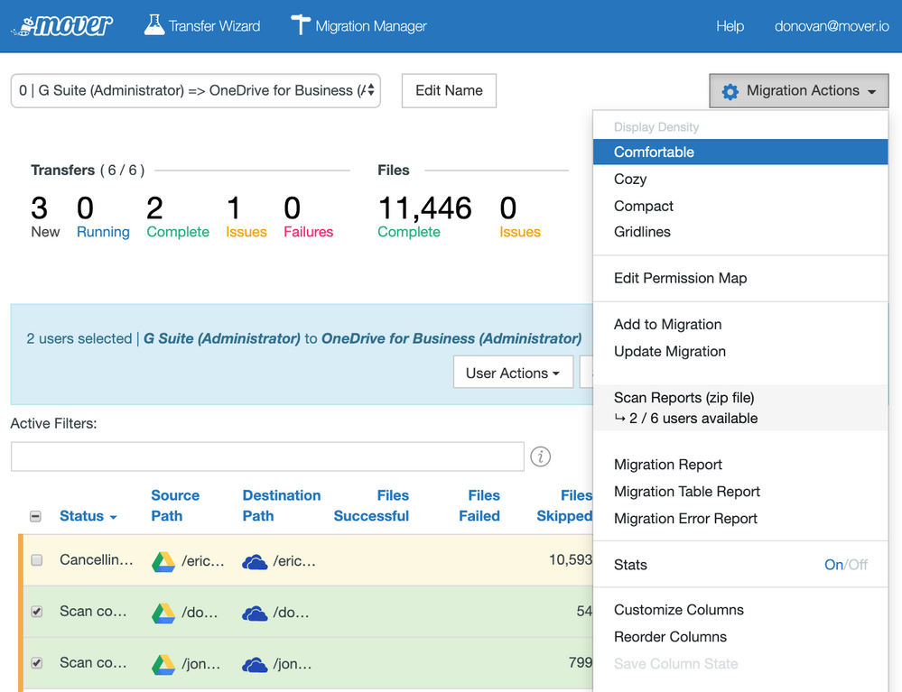
Mover Overview
Free, web-based migration tool.
Acquired by Microsoft in 2019.
"Migration Manager" dashboard provides a summary of the overall migration:
Notes:
Free, web-based migration tool service for migration of third-party cloud storage services to Microsoft 365.
Acquired by Microsoft in 2019.
Supports migration from over a dozen cloud service providers, including: Box, Dropbox, Egnyte, Amazon S3, Other O365 Tenants and Google Drive
"Migration Manager" dashboard provides a summary of the overall migration:

Slide 24
Migration Manager

Slide 25
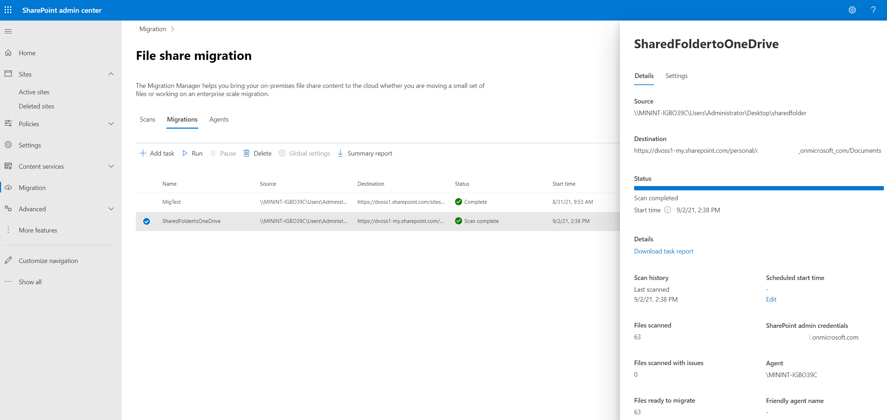
Migration Manager Overview
Simplifies large file share migrations by orchestrating hundreds of activities across multiple migration agents.
Built-in to the SharePoint Online Admin Center

Slide 26
Migration Manager Client Requirements
Component | Recommendation
CPU | 64-bit quad core processor or better
RAM | 16 GB
Local Storage | Solid state disk: 150 GB free space
Network card | 1 Gbps
Operating system | Windows Server 2012 R2 or Windows 10 client .NET Framework 4.6.2
Microsoft Visual C++ 2015 Redistributable | Required for OneNote migration.
https://docs.microsoft.com/en-us/sharepointmigration/mm-setup-clients
Notes:
Migration manager clients should be installed on machines meeting the following hardware requirements:

Slide 27

Large Migration Complexity
SPMT tasks, monitoring, must be performed on the machine individually.
Manually split the tasks csv and upload to the individual machines.
This process can be time consuming, resource intensive and complicated.
SPMT
SPMT
SPMT
SPMT
SPMT
SPMT
Tasks
Tasks
Tasks
Tasks
Tasks

Slide 28
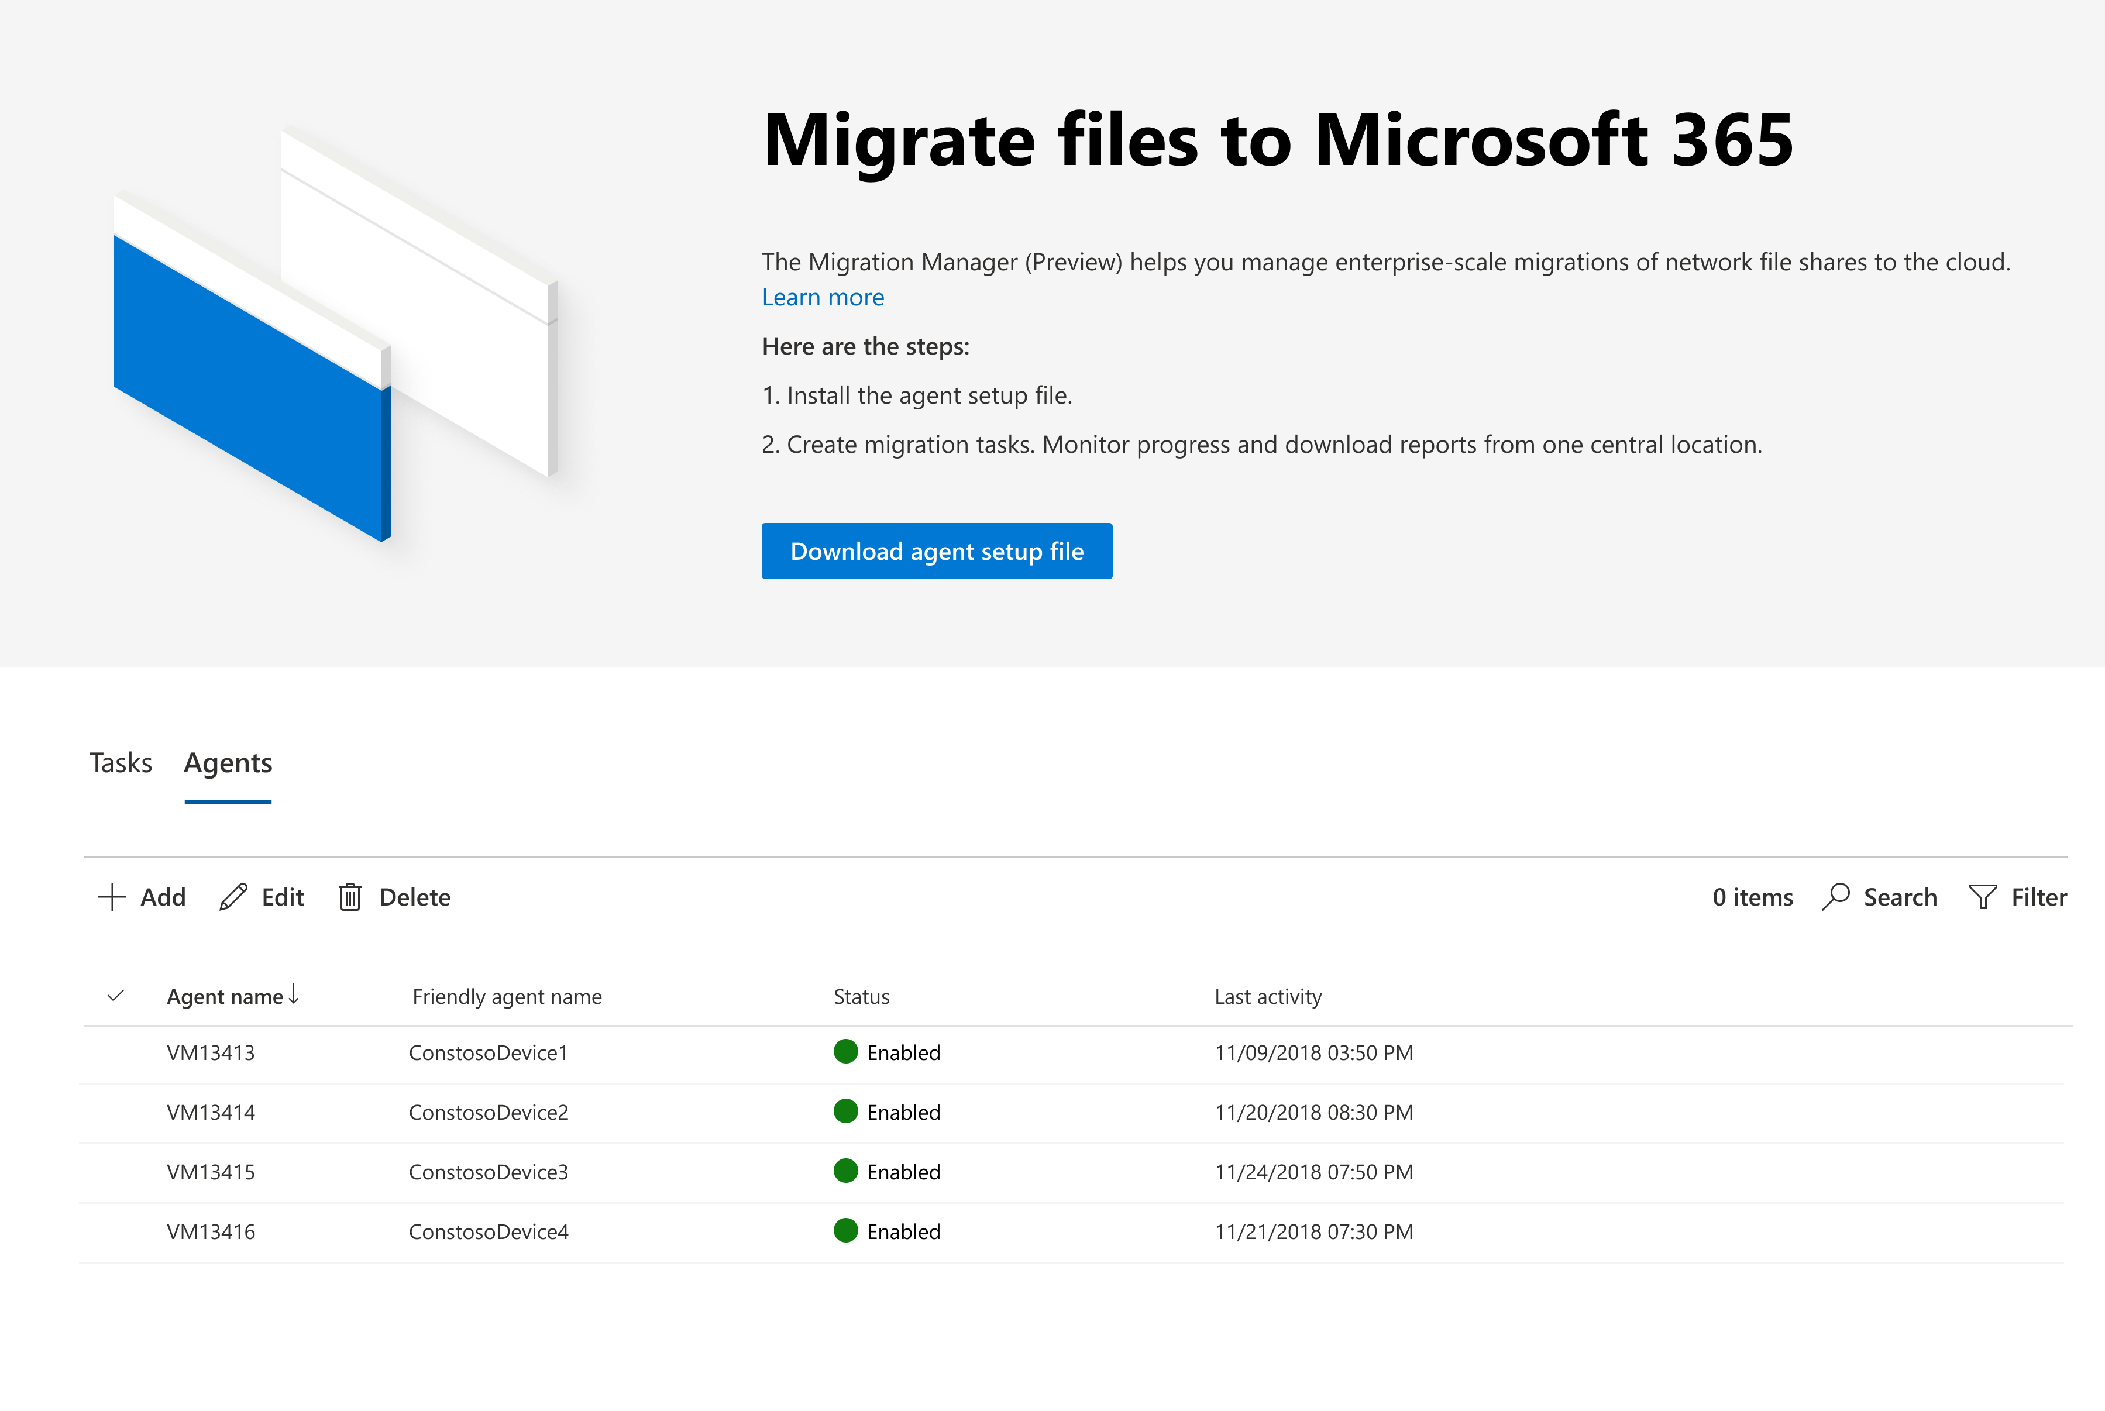
Migration Manager Simplifies Large Migrations
Simple/unified cloud-based migration experience.
Centrally managed from SharePoint admin center
Automatic load balancing across multiple agents
https://aka.ms/MigrationManager

Slide 29
SharePoint Migration Tool (SPMT)

Slide 30
SPMT Overview
Requirements/prerequisites
Permission handling
Limitations
Common issues and resolutions

Slide 31
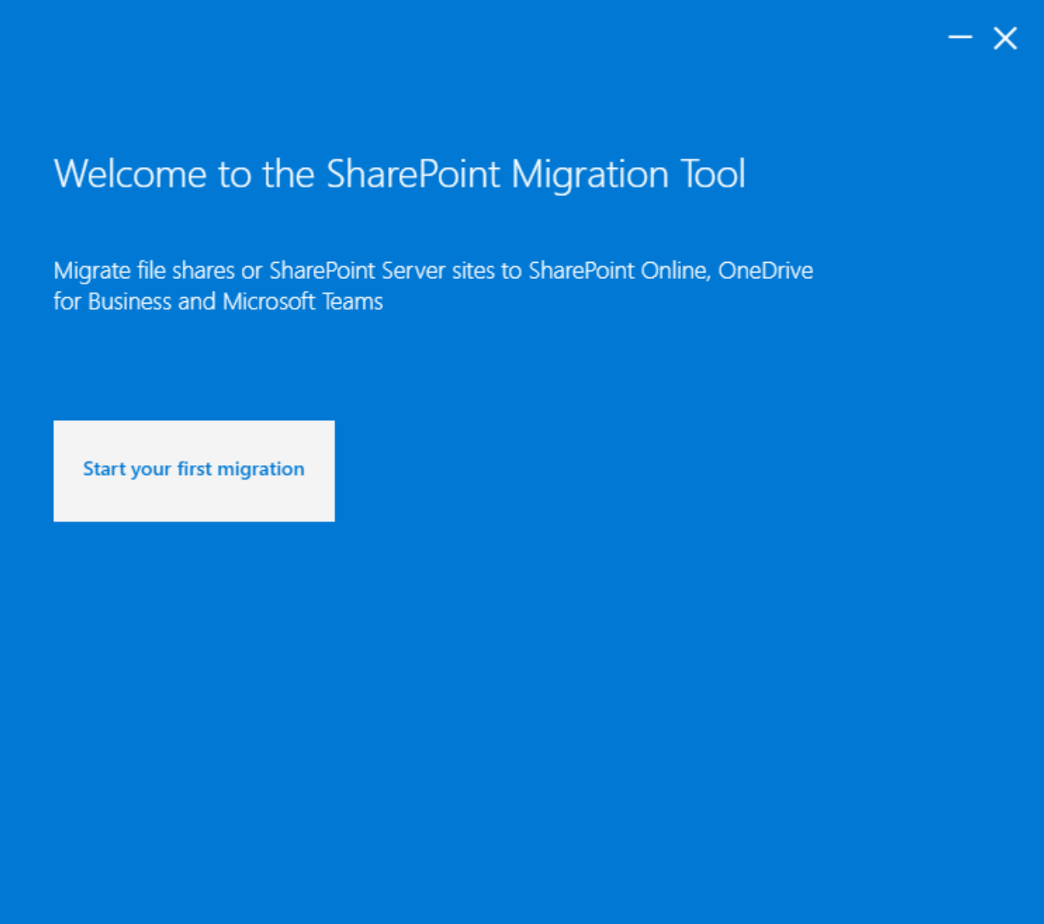


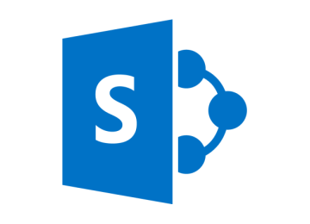

SPMT Migration Sources and Destinations
33 PB
Migrated content
84K
Unique tenants
*As of May 2020
https://aka.ms/SPMT
Notes:
https://aka.ms/SPMT
Sources: File shares, and SharePoint Server 2010, 2013 and 2019

Slide 32
SPMT Client Requirements
Component | Recommendation
CPU | 64-bit quad core processor or better
RAM | 16 GB
Local Storage | Solid state disk: 150 GB free space
Network card | 1 Gbps
Operating system | Windows Server 2012 R2 or Windows 10 client .NET Framework 4.6.2
Microsoft Visual C++ 2015 Redistributable | Required for OneNote migration.
https://docs.microsoft.com/en-us/sharepointmigration/spmt-prerequisites

Slide 33
Required Endpoints
https://secure.aadcdn.microsoftonline-p.com
https://login.microsoftonline.com
https://api.office.com
https://graph.windows.net
https://spmtreleasescus.blob.core.windows.net/
https://*.queue.core.windows.net
https://*.blob.core.windows.net
https://*.pipe.aria.microsoft.com
https://*.sharepoint.com
https://*.blob.core.usgovcloudapi.net (GCC only)
https://*.queue.core.usgovcloudapi.net (GCC Only)
https://spoprod-a.akamaihd.net
https://static2.sharepointonline.com
https://*. table.core.windows.net
Additional end points are required for automatic workflow migration. This is covered in the Migrate Workflows section later in this module. ☺
https://docs.microsoft.com/en-us/sharepointmigration/spmt-prerequisites
Notes:
The machine running SPMT or MM Agent must be able to communicate to the following required endpoints:
Additional end points required for automatic workflow migration – covered in the migrate workflows section later in this module. .

Slide 34
SPMT Download
Download Options
Current release: https://aka.ms/spmt-ga-page
Latest public preview: https://aka.ms/spmt-beta-page
Language Support
The SPMT tool has been localized across 11 languages, including:
Chinese (Simplified and Traditional), French, German, Italian, Japanese, Korean, Portuguese, Russian, Spanish, English
Note: The SPMT tool is not available for users of Microsoft 365 operated by 21Vianet in China. It is also not available for users of Microsoft 365 with the German cloud using the data trustee, German Telekom. However, it is supported for users in Germany whose data location is not in the German datacenter.

Slide 35
SPMT Migration Process
Authentication
Login to target tenant using Microsoft 365 account
Scan
Performed on every file
Verifies access to data source and write access to target (SharePoint Online)
Package
Content package is created containing manifest of 8 XMLs
Scans for known potential issues
Upload
Content package uploaded to Azure with manifest
Files & Manifest are encrypted
Import
Content imported from Azure to SharePoint Online
Scan and Resume
Session data is also stored locally and on users OneDrive for Business site
Allows the migration tool to resume any previous migration sessions.

Slide 36
SPMT: Supported SharePoint Elements
File, folder and list items
Permissions
Versions
Managed metadata and taxonomy, including content types and term stores. Global term store migration requires global tenant admin permissions
Site navigation and icons
OOTB SP2010 Workflows
Site features (not all but an extensive list)
SharePoint web parts
Site migration for sites that do not use any coding or 3rd-party tools
Site descriptions
Incremental
Pages in the site asset library
Notes:
https://docs.microsoft.com/en-us/sharepointmigration/what-is-supported-spmt

Slide 37
SPMT: Unsupported SharePoint Elements
Content Type Information Management Policy Settings (and data)
Audit Data (Compliance data)
Deleted Items Lists/Libraries/Sites (first or second stage)
Checked out file versions
Custom 2010 Workflows
Branding, Master Page, Page Layouts, theme, CSS
User Alerts
Newsfeed (MicroFeed)
Lists or Libraries with Audience Targeting enabled (default skipped, Setting can be changed to migrate without audience)
Some SharePoint Web Parts*
Some lists and libraries*
*Link to supported webparts/lists and libraries in the notes.
Notes:
List and library support: https://docs.microsoft.com/en-us/sharepointmigration/sharepoint-migration-supported-list-templates
Web part support: https://docs.microsoft.com/en-us/sharepointmigration/spmt-supported-webparts

Slide 38
File Shares: What’s Migrated?
Documents
File and folder structure
User level file and folder permissions
Files up to 100 GB
Document, and folder metadata
OneNote Notebooks

Slide 39
File Shares: What’s Not Migrated?
Conversion of embedded URLs in content
Windows hidden attributes on file and folder
Explicit deny permissions or custom NTFS permissions
Inaccessible or corrupted documents
Files or folders exceeding current SharePoint Online restrictions and limitations
Folder titled "Forms" cannot be migrated to the root of any Document Library
Notes:
When preparing for your file share migration, it is important to know what can being migrated when you use the SharePoint Migration Tool and what cannot

Slide 40
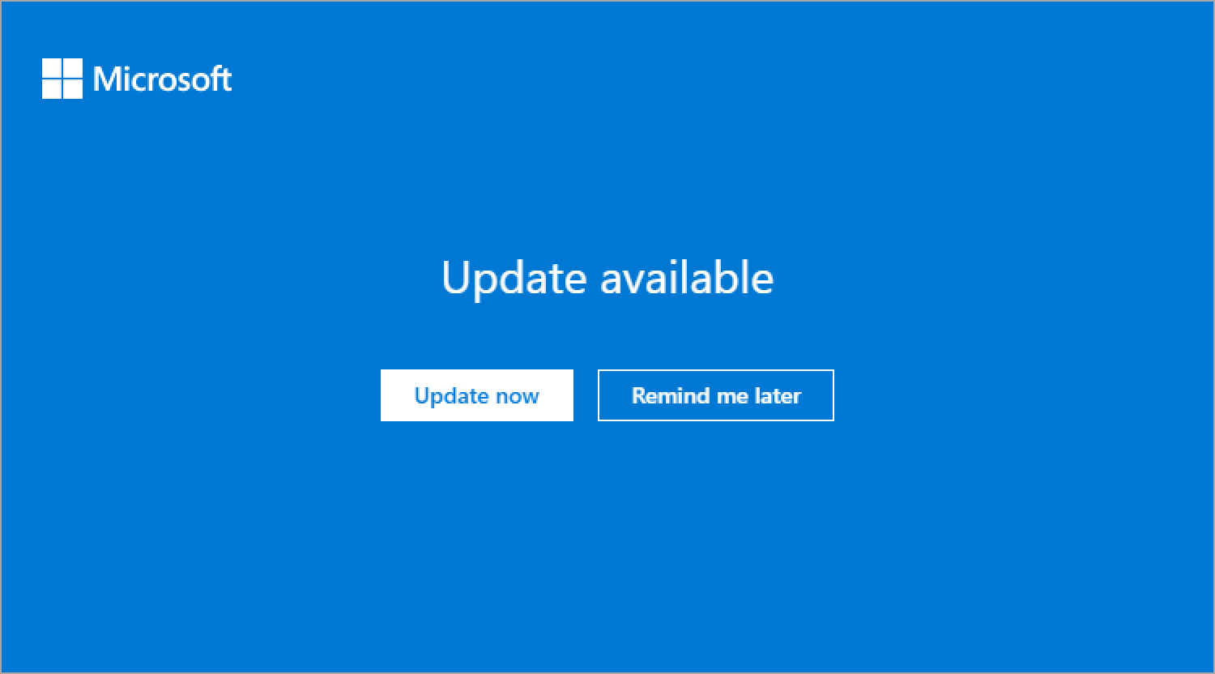
SPMT Release Notes and Updates
Updated regularly with new features.
Check release notes.
SPMT will notify you when there is an update.
Recommended to be on latest version.
https://docs.microsoft.com/en-us/sharepointmigration/new-and-improved-features-in-the-sharepoint-migration-tool

Slide 41
SPMT: Migrated Permissions

Slide 42
Permissions: File Share
Windows file share permissions | SharePoint item access | SharePoint role
Full control | Full control | Full control
Modify | Modify | Contribute
Read and execute | Read and execute | Read
List folder contents | List folder contents | Read
Read | Read | Read
Write | Write | Contribute
Notes:
The final permission level is determined by a mapping of the most restrictive share or NTFS permission level.
All advanced NTFS permissions are removed.
For explicit deny permissions, this means the content is subject to parallel permissions or permission on the folder and parent level and may become accessible.
Awareness
If a file has Write permission for user1, then the file will be set to Contribute for user1 in SharePoint Online.
If a file has Read permission for user1, then the file will be set to Read for user1 in SharePoint Online.
Note: At this time, the special permissions, such as Deny, will not be saved.
Create a user mapping file for data content migration
https://support.office.com/en-us/article/Create-a-user-mapping-file-for-data-content-migration-28c42985-1fd6-49d6-b9c5-b7f35e83efa1?ui=en-US&rs=en-US&ad=US
https://docs.microsoft.com/en-us/sharepointmigration/understanding-permissions-when-migrating

Slide 43
Permissions: SharePoint
User Mapping | File Share | SharePoint On-Premise
User mapped between on-premise and SharePoint Online using AAD Sync or User Mapping file | Two types of permissions are migrated: Read and Write. File with Write permissions on file share will be set to Contribute permission in SharePoint Online File with Read permissions on file share will be set to Read in SharePoint Online Note: At this time, the special permissions, such as Deny, will not be saved. | All unique permissions on a file will be migrated to SharePoint Online.
User not mapped (not using AAD Sync or user mapping file) | Files will be assigned the default permission of the location to which it has been migrated in SharePoint Online. | Files will be assigned the default permission of the location to which it has been migrated in SharePoint Online.
Notes:
Awareness
If a file has Write permission for user1, then the file will be set to Contribute for user1 in SharePoint Online.
If a file has Read permission for user1, then the file will be set to Read for user1 in SharePoint Online.
Note: At this time, the special permissions, such as Deny, will not be saved.
Create a user mapping file for data content migration
https://support.office.com/en-us/article/Create-a-user-mapping-file-for-data-content-migration-28c42985-1fd6-49d6-b9c5-b7f35e83efa1?ui=en-US&rs=en-US&ad=US
https://docs.microsoft.com/en-us/sharepointmigration/understanding-permissions-when-migrating

Slide 44
User Mapping File
SPMT/MM uses a default user mapping file that automatically handles Windows AD to Azure AD scenarios.
Reasons you might need to use a User Mapping file (.csv):
Windows AD users/groups are not synced with Azure AD.
Users have different accounts in Microsoft 365 then in Windows AD.
You want to change the source user/group permissions during migration.
SharePoint Server is not using Windows Auth (SAML, ADFS, FBA, etc.)
https://docs.microsoft.com/en-us/sharepointmigration/create-a-user-mapping-file-for-data-content-migration
Notes:
https://docs.microsoft.com/en-us/sharepointmigration/create-a-user-mapping-file-for-data-content-migration

Slide 45
Migration
Notes:
We will see the SPMT in action soon when we get to the Scenarios, but we'll introduce the process and how its used via PowerShell in this section

Slide 46
SPMT High Level Process
Login
Login to target tenant using Microsoft 365 account (Preferable Site Collection Admin)
Select type of Migration
New Migration
Continue Paused Migration
Select Source
SharePoint On-Premise
File Share
CSV file for bulk migration
Depending on Source selected
Provide additional migration details
Start Migration
Review Logs
Validate Migrated Content
Advanced Settings
Notes:
Format your JSON or CSV file for data content migration - SharePoint - Migrate to SharePoint and OneDrive | Microsoft Docs

Slide 47
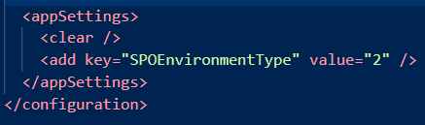
Government Cloud Support Additional Steps
1. Open microsoft.sharepoint.migration.common.dll.config
C:\Users\<Username>\Documents\WindowsPowerShell\Modules\Microsoft.SharePoint.MigrationTool.PowerShell
2. Change the value of SPOEnvironmentType to:
2 if you are GCC high or DoD
0 if you use the Worldwide consumer cloud or GCC
For example:
3. Double-click "microsoft.sharepoint.migrationtool.advancedapp.exe" to start SPMT.
Notes:
https://docs.microsoft.com/en-us/sharepointmigration/spmt-install-issues#government-cloud-support

Slide 48
SPMT Example PowerShell Script
#Define SharePoint 2010/2013 data source#
$Global:SourceSiteUrl = "http://YourOnPremSite/"
$Global:OnPremUserName = "Yourcomputer\administrator"
$Global:OnPremPassword = ConvertTo-SecureString -String "OnPremPassword" -AsPlainText -Force
$Global:SPCredential = New-Object -TypeName System.Management.Automation.PSCredential -ArgumentList $Global:OnPremUserName, $Global:OnPremPassword
$Global:SourceListName = "SourceListName"
#Define SharePoint Online target#
$Global:SPOUrl = "https://contoso.sharepoint.com"
$Global:UserName = "admin@contoso.onmicrosoft.com"
$Global:PassWord = ConvertTo-SecureString -String "YourSPOPassword" -AsPlainText -Force
$Global:SPOCredential = New-Object -TypeName System.Management.Automation.PSCredential -ArgumentList $Global:UserName, $Global:PassWord
$Global:TargetListName = "TargetListName"
Notes:
IMPORTANT: Just a quick reference only. This is included in Scenario Guide 4.3.
https://docs.microsoft.com/en-us/sharepointmigration/overview-spmt-ps-cmdlets

Slide 49
SPMT Example PowerShell Script Continued…
#Import SPMT Migration Module#
Import-Module Microsoft.SharePoint.MigrationTool.PowerShell
#Register the SPMT session with SharePoint Online credentials#
Register-SPMTMigration -SPOCredential $Global:SPOCredential -Force
#Add the migration task into the session. You can add multiple tasks (AKA multiple migration tasks: siteA, SiteB, FileShareA, FileshareB, etc)
Add-SPMTTask -SharePointSourceCredential $Global:SPCredential -SharePointSourceSiteUrl $Global:SourceSiteUrl -TargetSiteUrl $Global:SPOUrl –MigrateAll
#Start Migration in the console. #
Start-SPMTMigration
Notes:
IMPORTANT: Just a quick reference only. This is included in Scenario Guide 4.3.

Slide 50
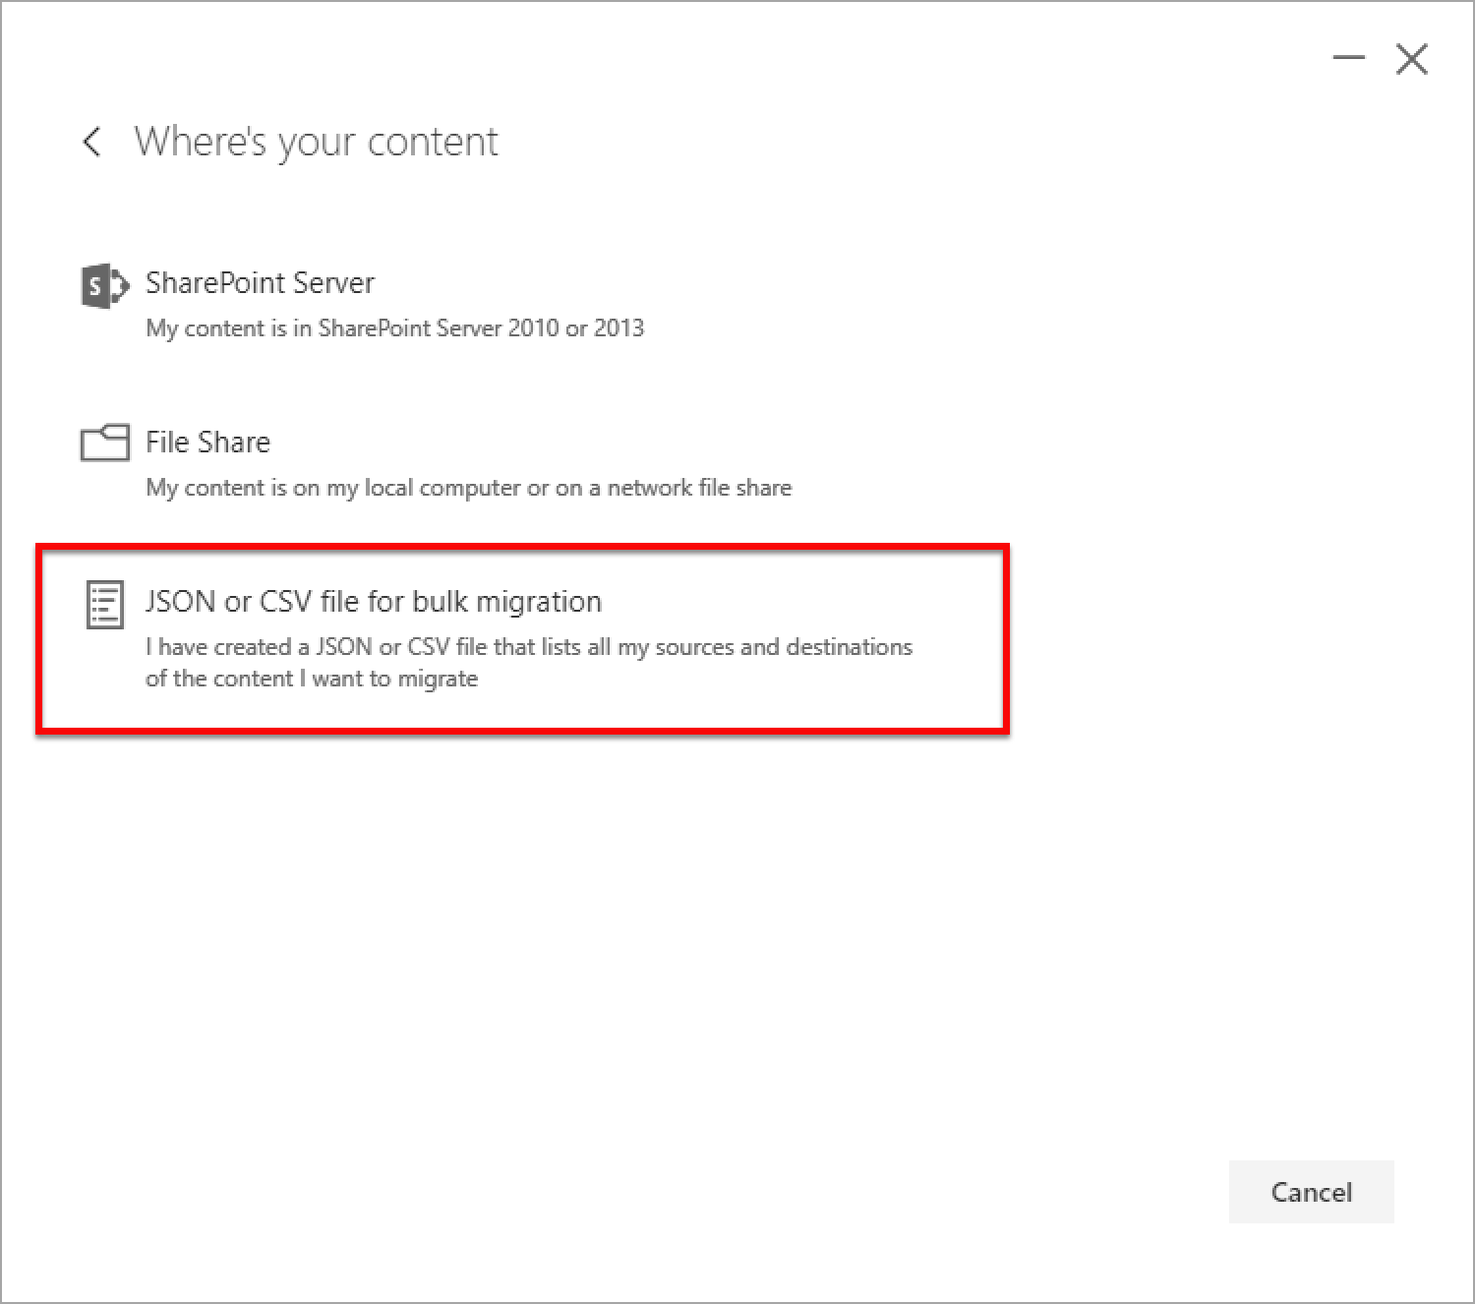
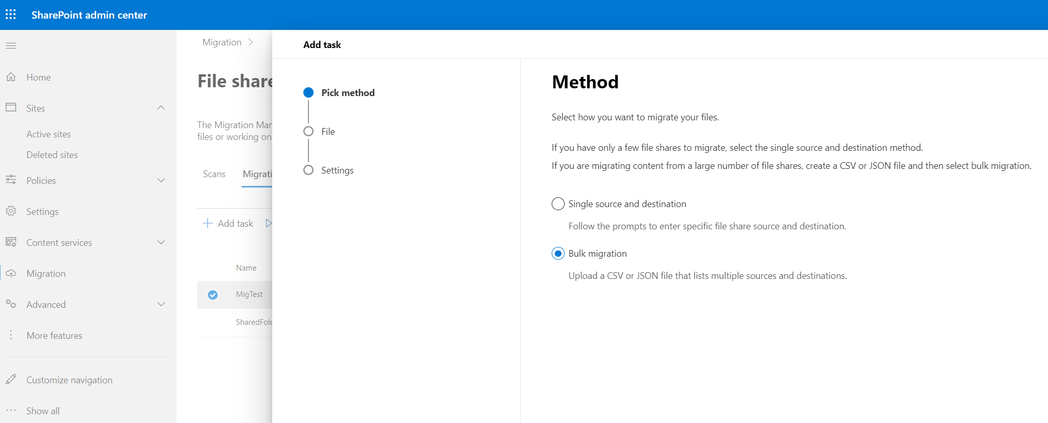
Bulk Migrations
SPMT/MM support bulk migrations. (CSV or JSON file)
Use any text editor to create the file.
Notes:
IMPORTANT: Just a quick reference only. This is included in Scenario Guide 4.1.
https://docs.microsoft.com/en-us/sharepointmigration/how-to-format-your-csv-file-for-data-content-migration

Slide 51
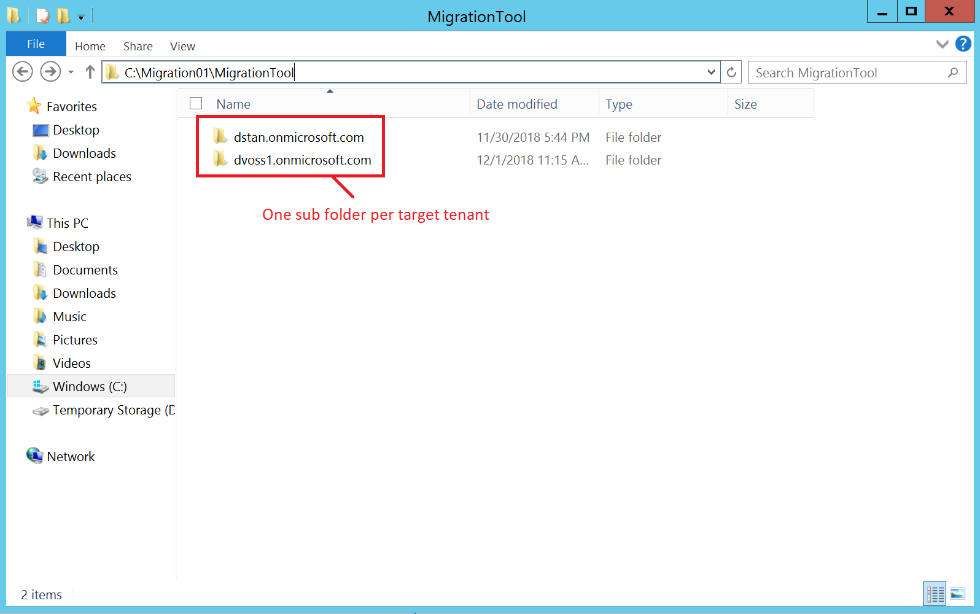
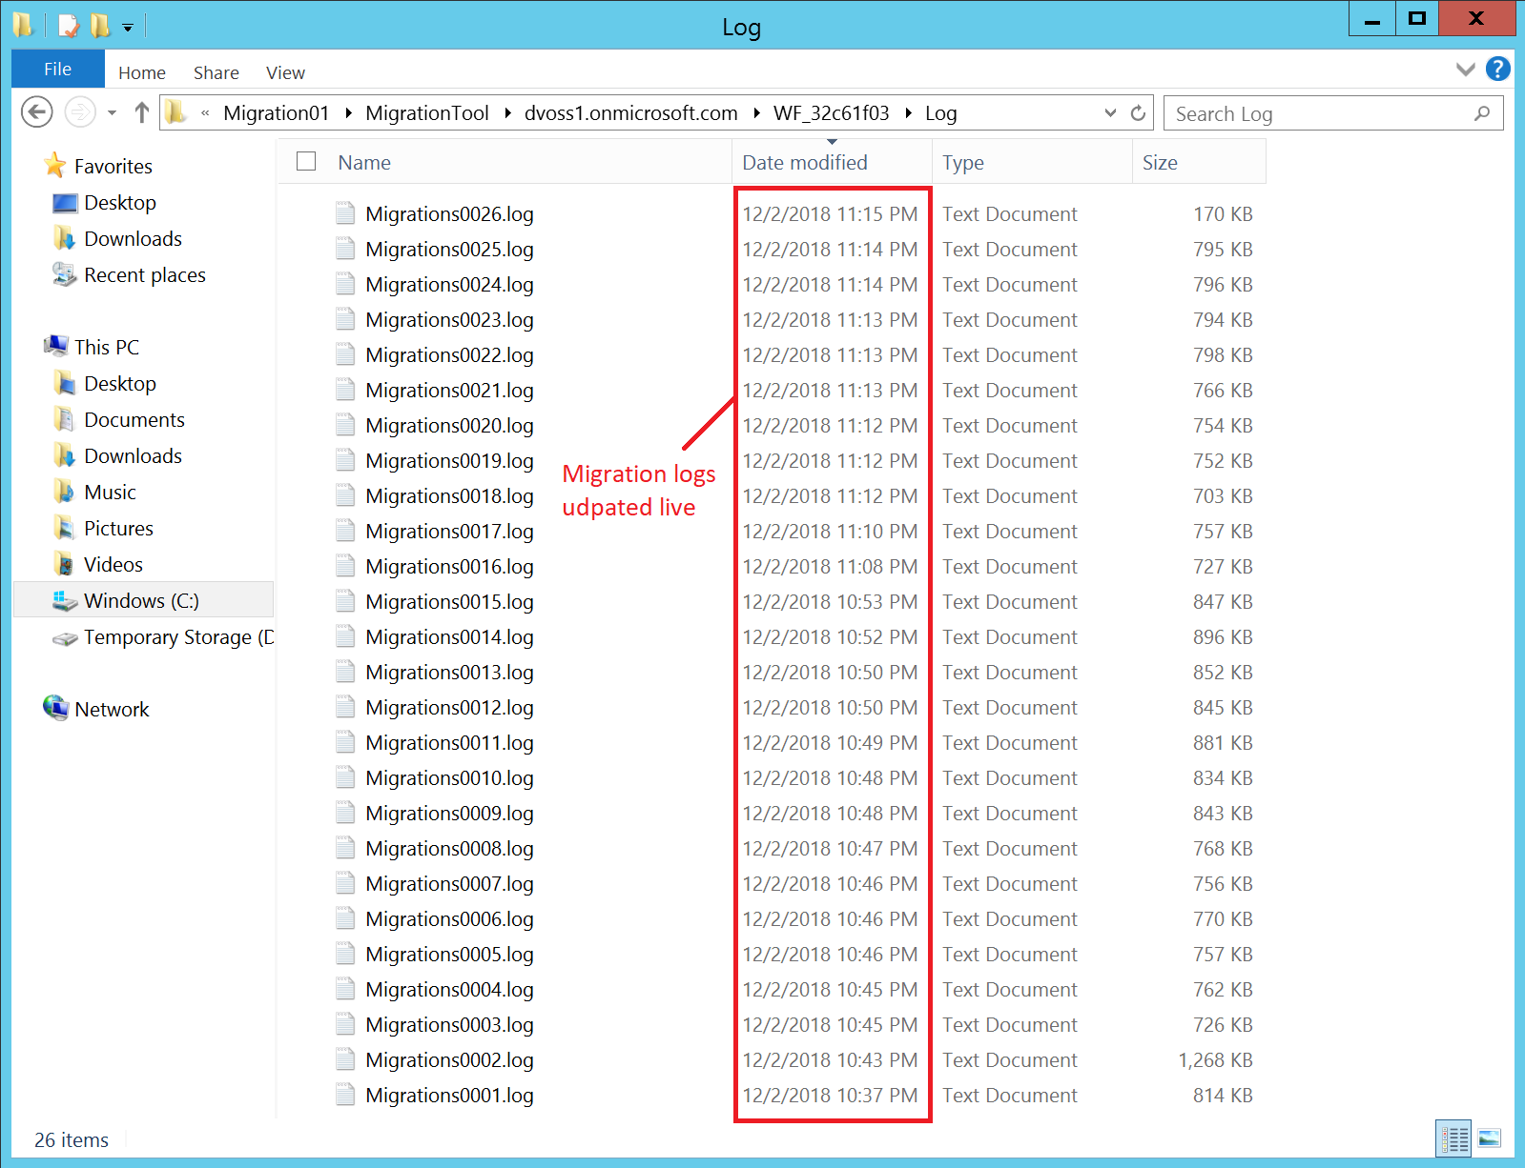
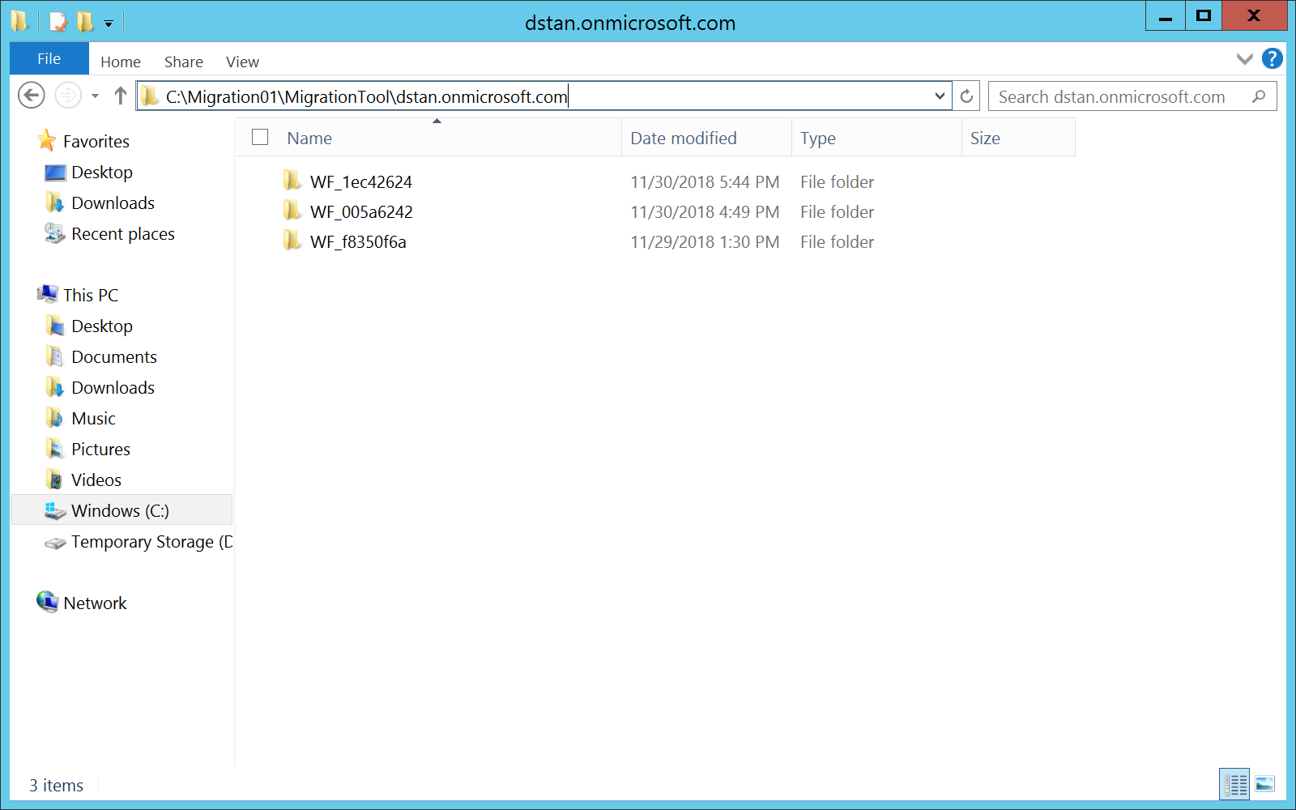
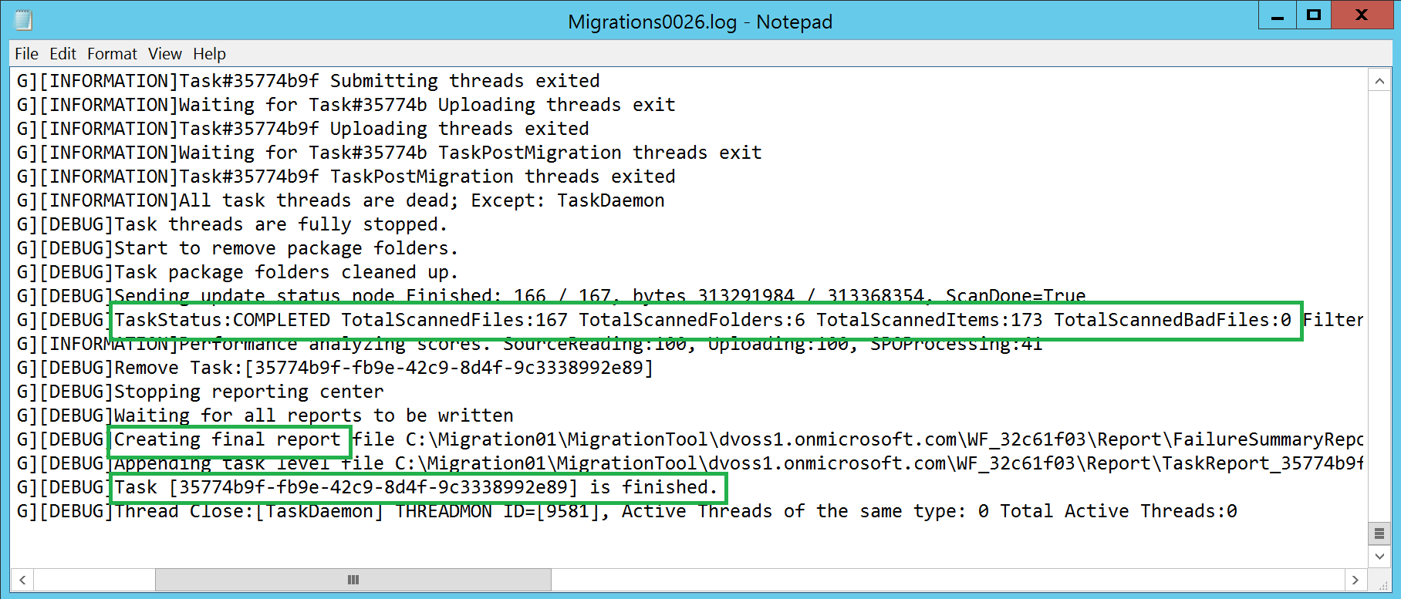
SPMT Local Migration Folder
One “work folder” per target SharePoint Online tenant
One sub folder for each Task
Logs provide live updates during the migration
Notes:
IMPORTANT: Just a quick reference only. This is included in Scenario Guide 4.3.

Slide 52
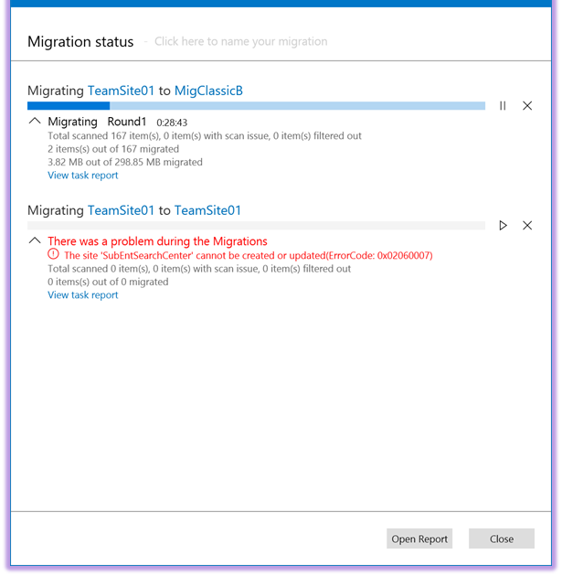
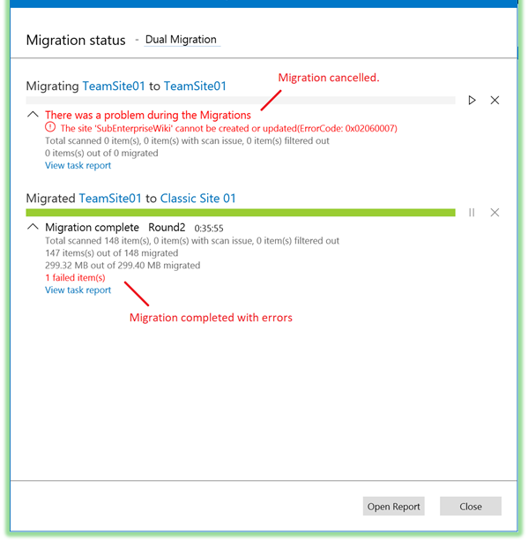
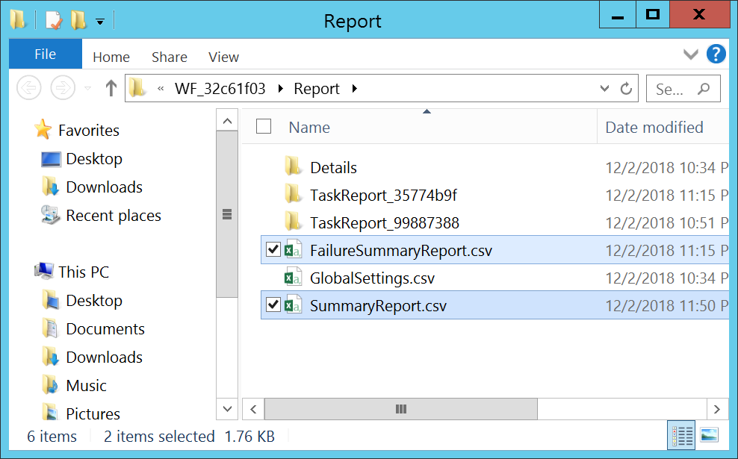
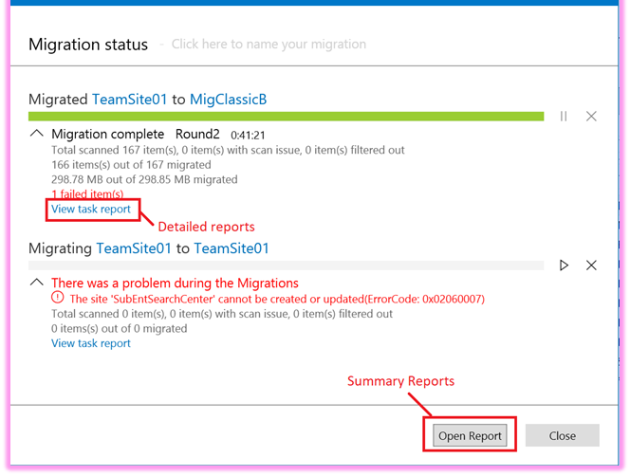
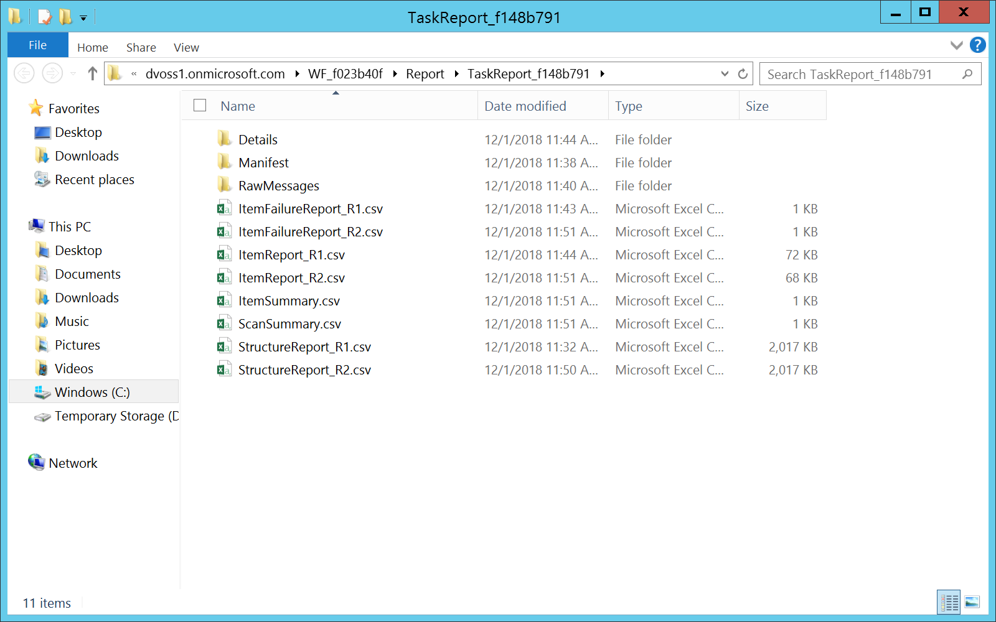
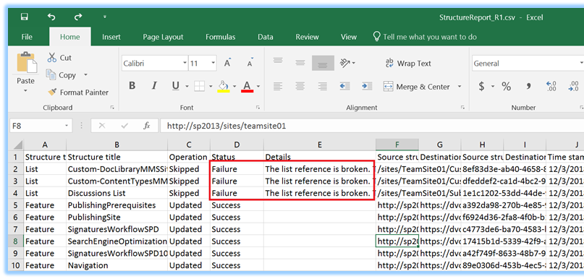
SPMT Migration Logging
Errors/Reports are announced in the tool
Summary Reports:
SummaryReport.csv
FailureSummaryReport.csv
Task Reports:
Item Report
Item Summary
Structure Report
Notes:
IMPORTANT: Just a quick reference only. This is included in Scenario Guide 4.1.

Slide 53
Migrate Workflows
Notes:
Learn how to Migrate OOB Workflows with SPMT

Slide 54
Migrate Workflows to Power Automate
Microsoft removed SharePoint Server 2010 workflow services November 1, 2020.
We recommend moving classic SharePoint Server workflows to Power Automate flows.
Using SPMT, you can now migrate:
SharePoint Server 2010 out of the box (OOTB) Approval and Collect Feedback workflows to PowerAutomate.
List and library "out-of-box" (OOTB) Approval workflows
Workflow definitions and associations.
This feature is currently in public preview and subject to change.
Expect additional capabilities in future releases. ☺
Communication is key!
Notes:
https://docs.microsoft.com/en-us/sharepointmigration/spmt-workflow-overview

Slide 55
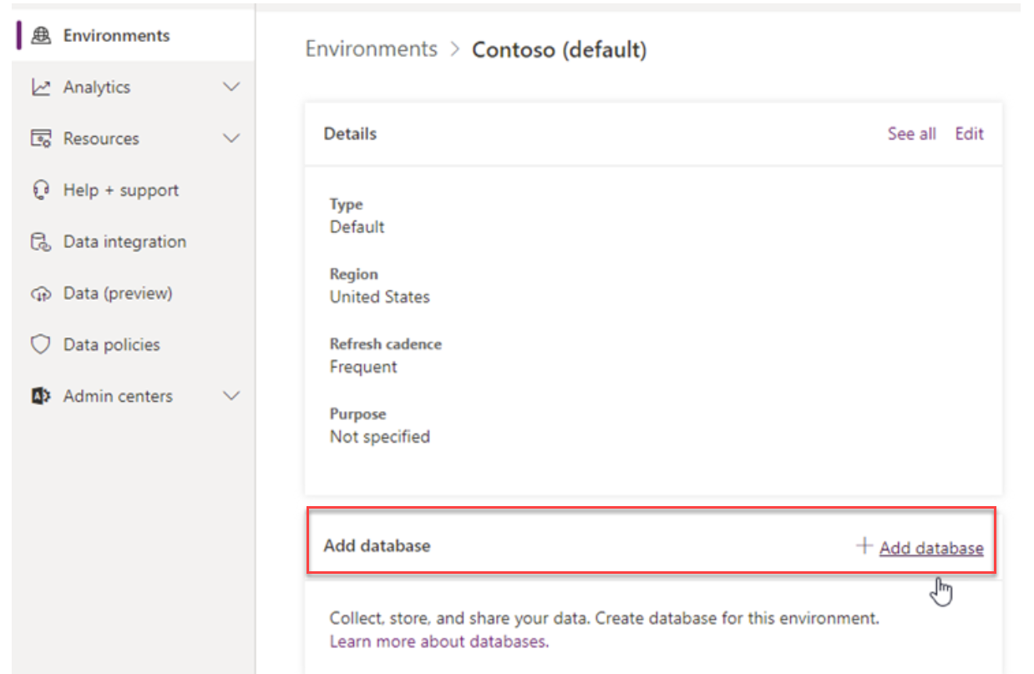
Configure Power Automate
Sign into Power Platform Admin Center (https://admin.powerplatform.Microsoft.com)
Select Add Database to your default environment
Configure end points:
Endpoint
https://service.powerapps.com
https://api.bap.microsoft.com
https://gov.service.powerapps.us
https://gov.api.bap.microsoft.us
https://high.service.powerapps.us
https://high.api.bap.microsoft.us
https://service.apps.appsplatform.us
https://api.bap.appsplatform.us
Notes:
It is required to be the Power Automate Admin to create the database.
https://docs.microsoft.com/en-us/sharepointmigration/spmt-workflow-overview

Slide 56
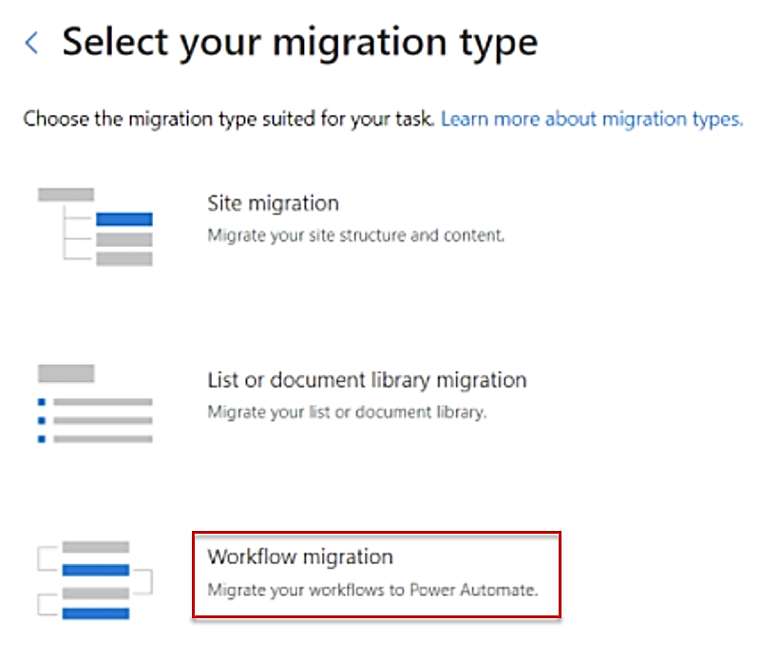
Workflow Migration with SPMT
Start new migration
Select SharePoint Server as your source
Select Workflow migration
Communication is key!
Notes:
Migrate SharePoint workflows with the SharePoint Migration Tool (SPMT) to Power Automate - Migrate to Microsoft 365 | Microsoft Docs
Step 2: Migrate SharePoint Server workflows with SPMT - Migrate to Microsoft 365 | Microsoft Docs

Slide 57
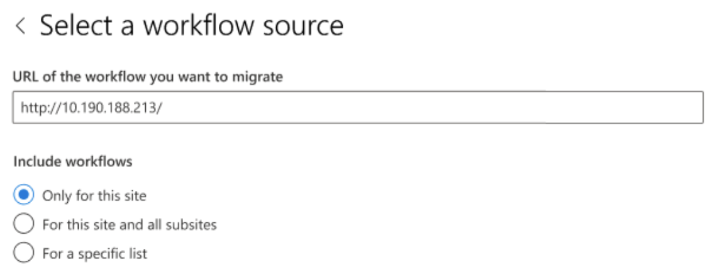
Workflow Migration with SPMT
Enter URL of SharePoint Server workflow.
Provide local credentials.
Select workflows to migrate.
If migrating workflow of a specific list/library, you’ll be prompted for list name.
Notes:
https://docs.microsoft.com/en-us/sharepointmigration/spmt-workflow-overview
https://docs.microsoft.com/en-us/sharepointmigration/spmt-workflow-step2

Slide 58
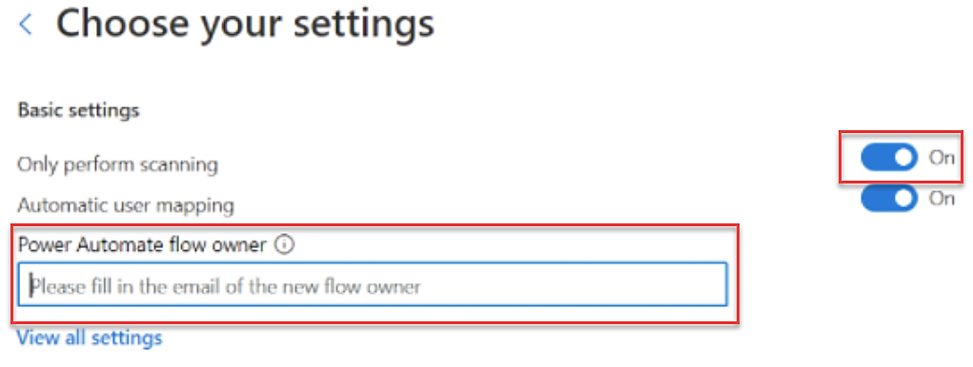
Workflow Migration with SPMT
Enter URL of target SPO site.
Click Next and Turn On Only perform scanning.
In the Power Automate Flow Owner box, enter the UPN of the new flow owner:
Communication is key!
Notes:
Migrate SharePoint workflows with the SharePoint Migration Tool (SPMT) to POwer Automate - Migrate to Microsoft 365 | Microsoft Docs
Step 2: Migrate SharePoint Server workflows with SPMT - Migrate to Microsoft 365 | Microsoft Docs

Slide 59
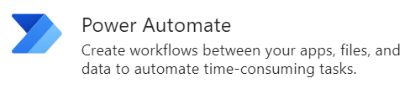
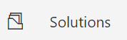
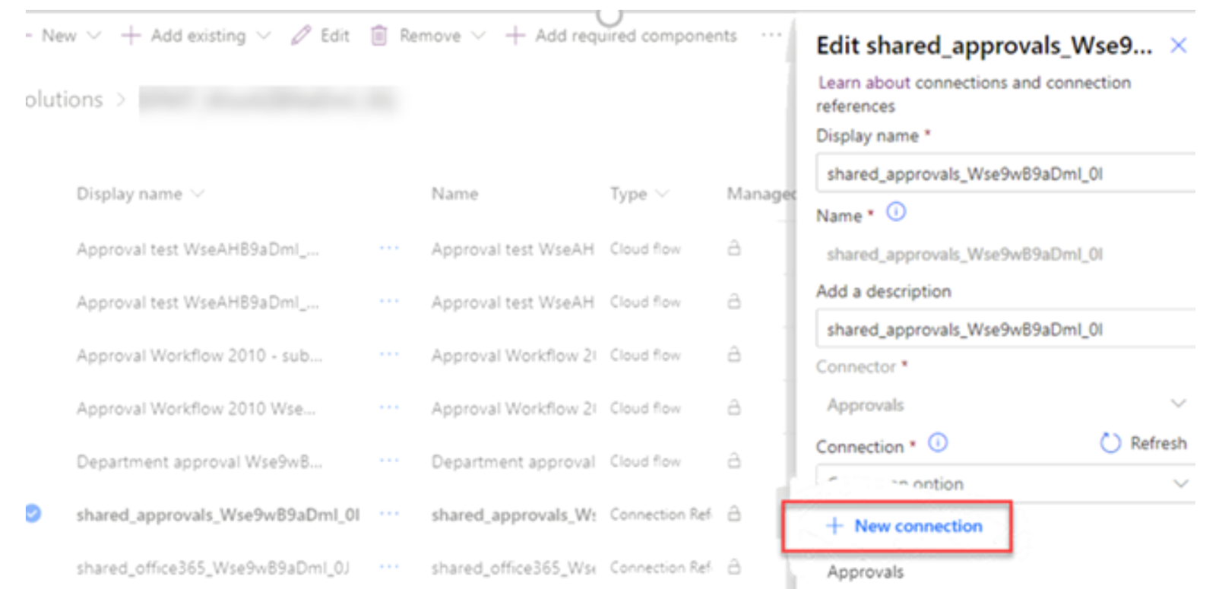
Activate Migrated Workflows
Sign into Power Automate
Navigate to Solutions
Choose the name of the solution matching your migration
Edit connection references
Communication is key!
Notes:
https://docs.microsoft.com/en-us/sharepointmigration/spmt-workflow-overview
https://docs.microsoft.com/en-us/sharepointmigration/spmt-workflow-step3

Slide 60
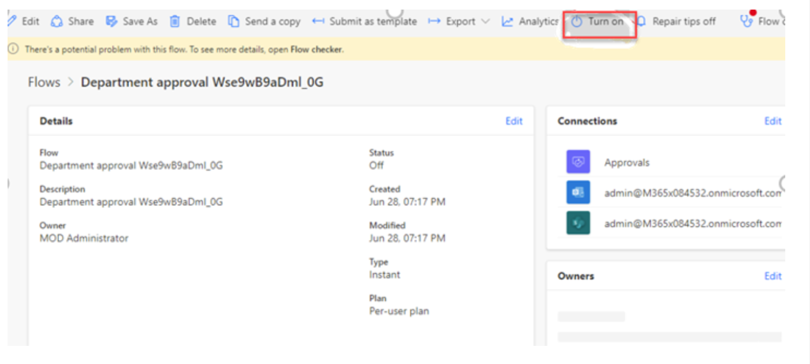
Activate Migrated Workflows
Turn on Flow after connections are configured.
Always test after activation.
Communication is key!
Notes:
https://docs.microsoft.com/en-us/sharepointmigration/spmt-workflow-overview
https://docs.microsoft.com/en-us/sharepointmigration/spmt-workflow-step3

Slide 61
SPMT: Troubleshooting common issues and errors

Slide 62
SPMT Installation Issues
Ensure the migration machine has the recommended hardware requirements.
Ensure the migration machine has the correct software prerequisites installed: .NET 4.6.2 and Microsoft Visual C++ 2015 Redistributable for X64
Ensure the migration machine can reach the required endpoints.
Make sure that any third-party antivirus installed on the migration machine is not interfering
https://docs.microsoft.com/en-us/sharepointmigration/spmt-install-issues

Slide 63
SPMT Migration Issues and Errors
Message | Do this
We are unable to connect to the site you provided | Check if the list exists or if you can access it in the source site and target site from your computer. Confirm you have signed into SPMT with an account that has access to the site. Confirm the URL you entered is correct and follows the proper format. Example: https://contoso.sharepoint.com/teams/SiteTitle
Invalid source folder | Confirm the path you entered is correct and follows the proper format. Confirm the user of SPMT has read access to the folder. "Forms" is a reserved/hidden folder for the Root of all Document Libraries
The site cannot be created or updated | Confirm the URL is valid. Confirm you are the site collection administrator. Create the site manually and point the migration tool to this newly created site.
Scan file failure: The folder name is invalid | See Invalid file names and file types in OneDrive and SharePoint
Scan file failure: Target path is too long | The entire path must contain fewer than 400 characters. (this applies to OneDrive, OneDrive for Business and SharePoint Online)
https://docs.microsoft.com/en-us/sharepointmigration/troubleshooting-common-spmt-issues

Slide 64
Migration Issues FAQ
My migration is going slow. What can I do?
I am continually getting throttled while I attempting to migrate. Can Microsoft turn off the throttle to help me with migration?
How much can I migrate per day?
I have tried everything, but nothing works. Now what do I do?
My migration is blocked with a consistent high volume of Http 503 errors (“Server Too Busy”)?
Notes:
Q: My migration is going slow. What can I do? A: Check that you have configured your migration settings properly. Turn off any software that you do not need to use during migration. For example, disable any file synchronization program or antivirus program on the migrated content.
Q: I am continually getting throttled while I attempting to migrate. Can Microsoft turn off the throttle to help me with migration? A: Unfortunately, we are not able to disable throttle. Throttling is in place to protect the reliability and availability of the service. If after several days you are still experiencing excessive throttling, please open a Microsoft support ticket.
Q: How much can I migrate per day? A: Plan to migrate at a maximum of 2TB/day. For customers migrating greater than 100TB of data, please follow the instructions on how to create a support ticket to help the product team to prepare the backend for the customers.
Q: I have tried everything, but nothing works. Now what do I do? A: Open a support ticket from http://admin.microsoft.com
Q: My migration is blocked with a consistent high volume of Http 503 errors (“Server Too Busy”) ? A: If you are experiencing a high volume of HTTP 503 responses blocking your migration for extended period of time, please follow the steps below to create a support ticket.
https://docs.microsoft.com/en-us/sharepointmigration/sharepoint-online-and-onedrive-migration-speed
Please refer to Avoid getting throttled or blocked in SharePoint Online for more information.
Please check up guidance in this document, plus refer to Please refer to Avoid getting throttled or blocked in SharePoint Online for more information on Microsoft throttling guidance. For specific tools configuration or questions, please contact your third party tools vendor for more information. This will help reduce throttle and improve performance.

Slide 65

Feedback
Feedback in SPMT tool
Share feedback in the migration tool: →
Notes:
https://aka.ms/migrationuservoice

Slide 66
Scenario 4.1 Migrate SharePoint Server content to SharePoint Online

Slide 67
Scenario 4.2 Migrate SharePoint Server content to SharePoint Online then connect to Microsoft Teams

Slide 68
Scenario 4.3 Automate migration to SharePoint Online using PowerShell

Slide 69

End of Presentation

